Slide 1
Meeting with COGTA MEC L. Maile and Executive Mayor
12 June 2019
Sedibeng District Municipality

Slide 2
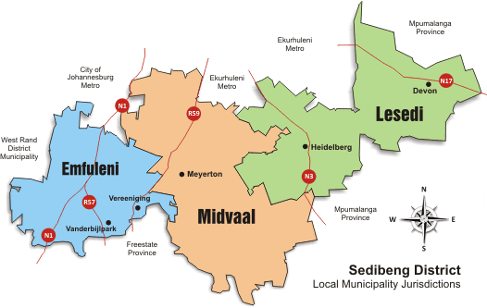
Setting the Scene – Sedibeng District Municipality

Slide 3
ROLE OF SEDIBENG DISTRICT MUNICIPALITY

Slide 4
The Role of Sedibeng District Municipality
SDM is a district municipality responsible for
  Developing the Sedibeng region (Growth and Development Strategy and Local Economic Development)
  Certain functions including:
    Registration and Licensing
    Environment
    Heritage
  Planning, co-ordination and support to local municipalities
Our ‘seat’ of government are located in Vereeniging.

Slide 5
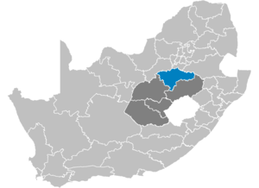
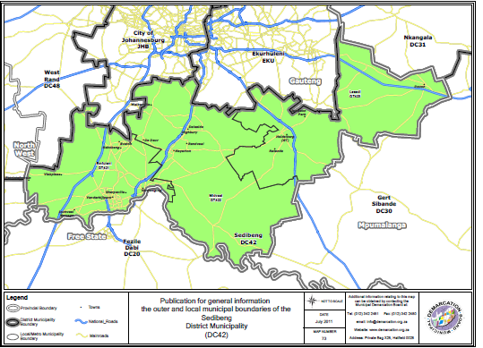
Some Facts and Findings about the region:
Towns include: Sebokeng, Evaton, Vanderbijlpark, Vereeniging, Meyerton, Heidelberg, Sharpeville, Bophelong, Boipatong, Devon
Population: Between 800 000 and 1 million people
Economy: 9th largest economy in South Africa
  Manufacturing sector has been experiencing a growth decline resulting in job losses.
Notes:
Add pictures.

Slide 6
Some Facts and Findings about the region: CONTD
  Labour market indicators in Sedibeng
52.5%
Source: IHS Markit, 2019

Slide 7
Some Facts and Findings about the region. CONT…
Share of households Without access to services in Sedibeng
Sedibeng
Emfuleni
Midvaal
Lesedi
Formal Housing
Sanitation
Water
Electricity
Refuse Removal
Source: IHS Markit, 2019
Of all the household infrastructure, there seems to be a greater share of the district’s population living without formal housing

Slide 8
Institutional capacity and good governance structures

Slide 9
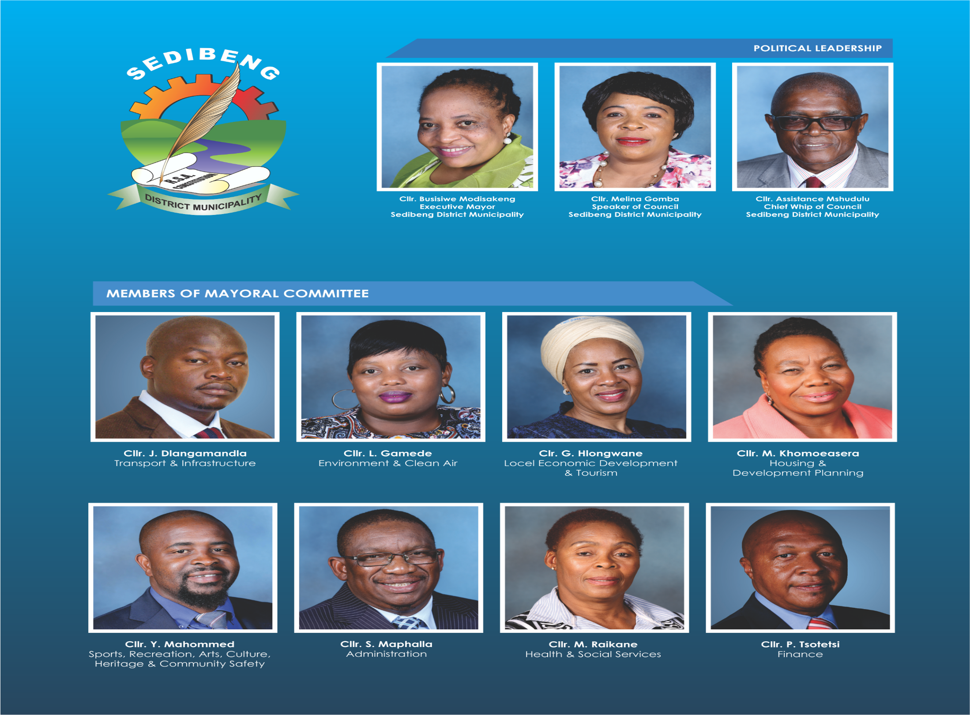

Slide 10
Administrative Governance - SDM
Administrative Governance - SDM
NAME AND SURNAME | POSITION
Mr. Stanley Khanyile | Municipal Manager
Mr. Johanis Kasvosve | Chief Financial Officer
Mr. M. Makhutle | Executive Director: Corporate Services
Mrs. Jabulile Medupe | Executive Director: Community Services
Mr. Zwelibanzi Majola | Executive Director: Strategic Planning and Economic Development
Mr. Mpho Thekiso | Executive Director: Transport, Infrastructure and Environment (Acting)
Mr. Archie Mokonane | Director: Office of the Executive Mayor
Mr. M. Mpontshane | Director: Office of the Speaker of Council
Mr. J. Tsoho | Director: Office of the Chief Whip of Council

Slide 11
Governance Structures - SDM
Committees of Council established according to Local Government Structures Act of 1998, Section 33 are as follows:
  Elections Committee
  Ethics Committee
  Rules Committee
  Gender Committee
  Municipal Public Accounts Committee
  Petitions Management Committee
  Audit Committee

Slide 12
IGR Structures in Sedibeng District Municipality
(Political Coordination Structures and Status)
IGR Structures in Sedibeng District Municipality
(Political Coordination Structures and Status)
IGR
Joint Mayors Forum
Joint Mayoral Committee
Section 80 Committees
MEC/MMC Forum
Premiers Coordinating Forum
IGR Structure | Frequency | Level of functionality
Joint Mayors | Quarterly | Functional / Regular
Joint Mayoral Committee | Quarterly | Functional / Irregular
Section 80 Committees | Monthly | Varies from portfolio to portfolio
Premiers Coordinating Forum | Quarterly | Functional / Regular
MEC/MMC Forum | Quarterly | Functional / Regular

Slide 13
IGR Structures in Sedibeng District Municipality
(Administrative Coordination Structures and Status)
IGR Structures in Sedibeng District Municipality
(Administrative Coordination Structures and Status)
IGR
Joint Municipal Managers Forum
CFO’s Forum
IDP Planning Forum
Technical & Administrative Support Forum
IGR Forum | Frequency | Level of functionality
Joint Municipal Managers | Monthly | Functional / Regular
CFO’s Forum | Quarterly | Functional / Regular
Technical & Administrative Support Forums | Quarterly | Functional / Irregular
IDP and Budget Lekgotla | Quarterly | Functional

Slide 14
Financial viability

Slide 15
Financial Viability
Budget 2019/20:
  The total estimated operating revenue of R405,811,181;
  The total estimated operating expenditure of R429,062,341;
  Resulting in an operational deficit of R23,251,160 and
  The total estimated Capital Budget of R1,750,000
  Resulting in a total deficit of R25,001,160

Slide 16
Financial Viability CONTD
Employee related costs comprise 71,5% of total revenue;
Repairs and Maintenance budgeted at 2,3% of total revenue (benchmark is 8%); implication of insufficient funds available to allocate towards maintaining municipal infrastructure;
Contracted services make up 13,3% of total revenue;
General expenses at 10% of total revenue;

Slide 17
Financial Viability CONTD
The 2017/18 financial year closed on an operating deficit of R89,3million;
Employee related costs comprise 71,5% of total revenue;
Salaries budgeted in 2019/20 at R276 million while Equitable Share allocation is R268 million;
Heavy dependency on grants: 74% of total revenue from transfers & subsidies;
Cash flow constraints resulted in debt of R90 million owing to Dept. of Transport;
Rejection of application for roll-over of 2017/2018 grant allocations resulting in R14 million of unspent grants due payable

Slide 18
IDP Alignment to NDP and TMR and our Priority Projects

Slide 19
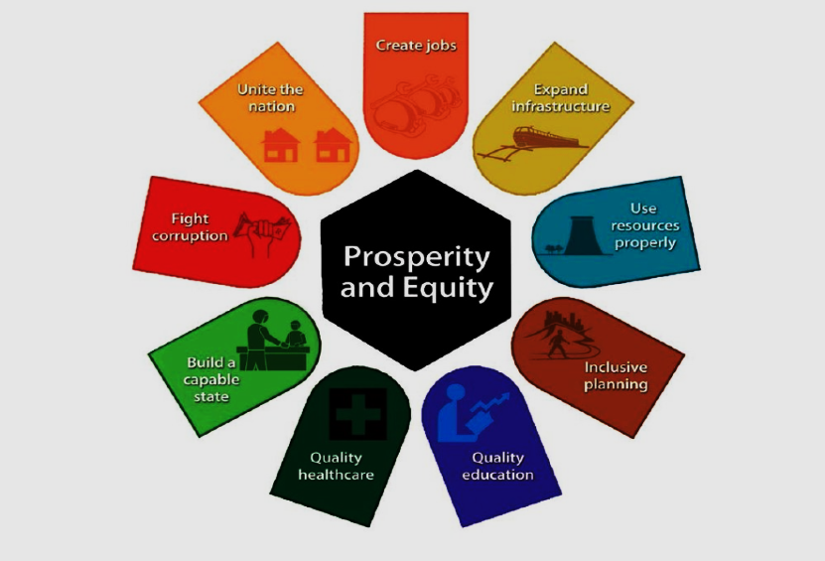
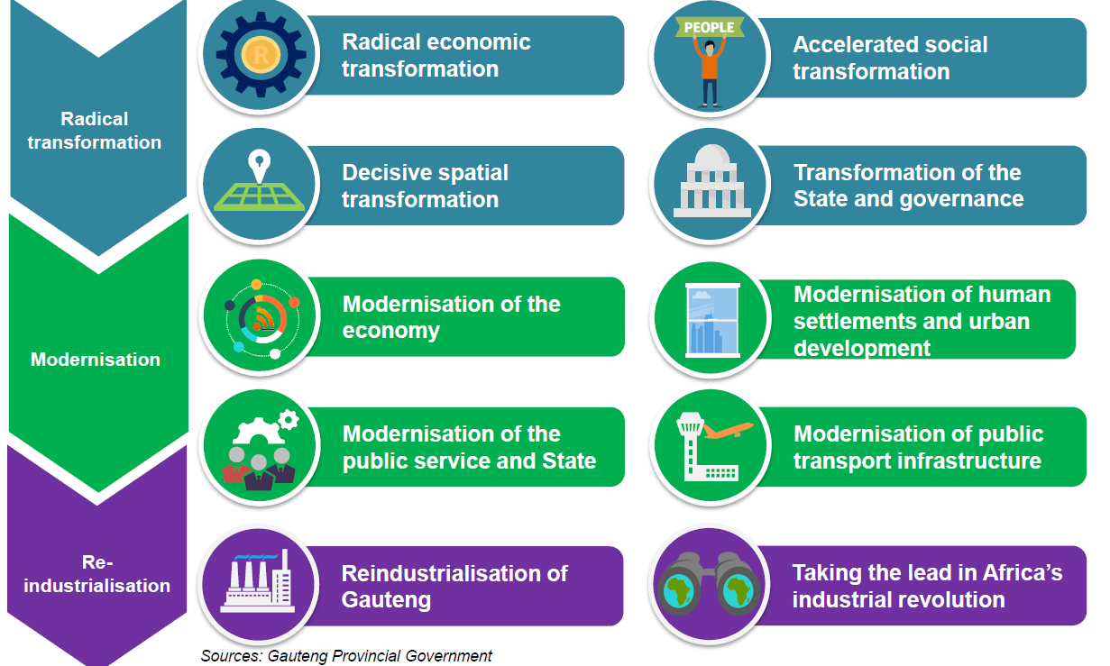
IDP Alignment to National and Provincial Strategy
Policy, Plans and Strategy document | Key Focus Area
1. National Development Plan (Vision 2030) | Economy and Employment Better and more sustainable livelihoods Economic Infrastructure Development Inclusive Rural Economy Quality Education, Training and Innovation
2. Gauteng TMR Approach (Transformation, Modernization and Reindustrialization) | Radical Economic Transformation Modernization of the Economy Reindustrialization of Gauteng Modernization of Human Settlement and Urban Development
3. Sedibeng Growth and Development Strategy Pillars (SGDS) | Reinventing the Economy Renewing Our Communities Reviving our Environment Reintegrating the Region Releasing Human Potential Good and Financially Sustainable Governance Vibrant Democracy

Slide 20
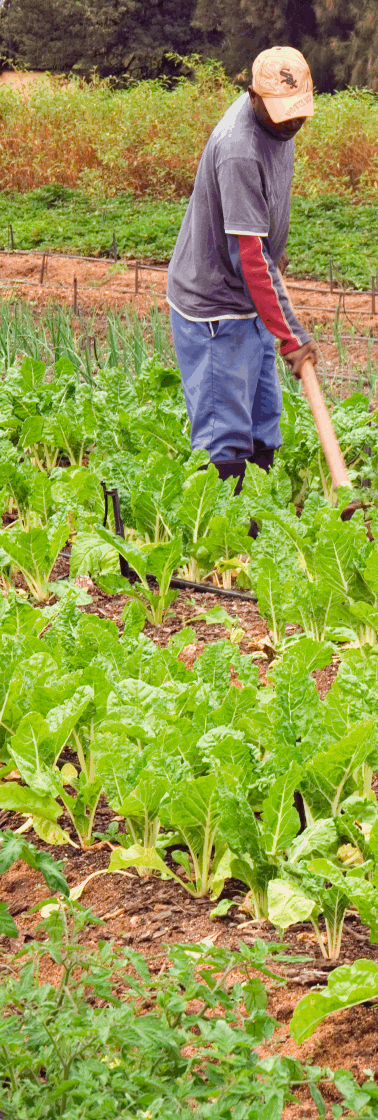
Our Priority Projects 2019/20 (Southern Corridor)
1.
Doornkuil
Status Quo – The Projects Requires feasibility study
Challenges – Availability of Funding
Interventions – GDARD to fund the full feasibility study of the precinct plan
Status Quo – Feasibility Study has been finalised and letter to solicit views and recommendations from Treasury has been issued.
Challenges – Funding
Interventions – Provincial and National departments to assist with funding towards a full feasibility study to be conducted on the earmarked properties of the precinct plan
2.
Fresh Produce Market
3.
Graceview Industrial Park
Status Quo – Awaiting sewer connection from ERWAT
Challenges – Internal and External Bulk services availability
Interventions – Office of the Premier to convene a meeting between the district, ERWAT and the developer

Slide 21
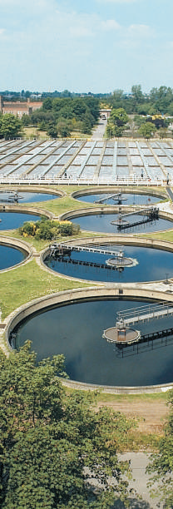
Our Priority Projects 2019/20 (Southern Corridor)
4.
Lesedi Transit Hub
Status Quo – The Projects Requires feasibility study
Challenges – Availability of Funding
Interventions – Department of Economic Development (DED) to assist with funds towards the required feasibility study
5.
Langzeekoeigat Precinct
Status Quo – Department of Rural Development & Land Reform has availed funding for feasibility study
Challenges – N/A
Interventions – N/A
6.
Sedibeng Regional Sewer Scheme (SRSS)
Status Quo – Module six (6) is at 96% percent completion.
Challenges – Legal implications due to Environmental lobby groups taking action against the Municipal Manager and the Municipality for pollution of the water and river systems
Interventions – Allocations of Powers and Functions to the District Municipality

Slide 22
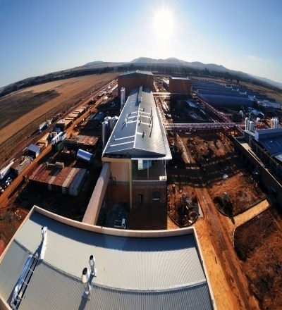
Our Priority Projects 2019/20 (Southern Corridor)
7.
The Graceland
Status Quo – Township establishment approved
Challenges – Internal and External Bulk services availability
Interventions – Office of the Premier to convene a meeting between the district, Department of Human Settlements, Department of Water And Sanitation, Rand Water and the developer
8.
Heidelberg CBD
Status Quo – Ready for implementation
Challenges – Investors
Interventions – DED to assist with finding suitable investors
9.
Vaal Logistics Hub
Status Quo – Busy with Town-Planning processes
Challenges – Public Funding
Interventions – Source Funds for the project

Slide 23

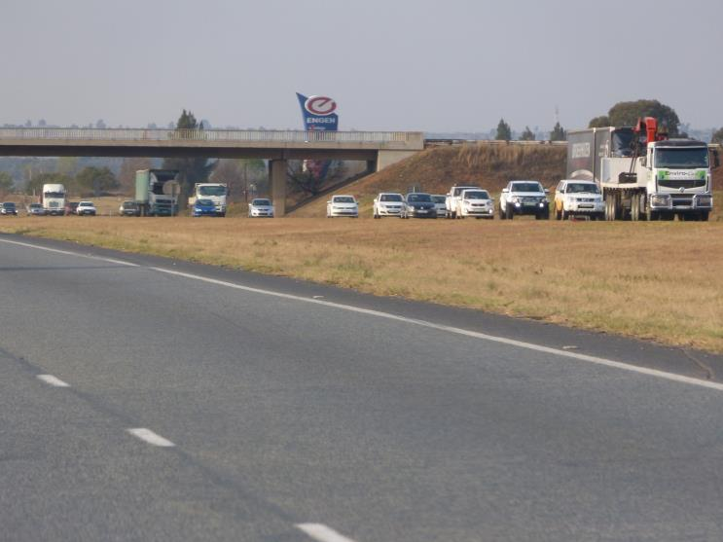
Our Priority Projects 2019/20 (Southern Corridor)
10.
The Vaal River City
Status Quo – Township establishment approved
Challenges – Internal and External Bulk services availability
Interventions – Office of the Premier to convene a meeting between the district, Department of Human Settlements, Department of Water And Sanitation, Rand Water and the developer
11.
Vereeniging Government Precinct
Status Quo – Feasibility Study is underway
Challenges – Investors
Interventions – DED to assist with finding suitable investors
12.
R59 Corridor
Status Quo – Busy with Town-Planning processes
Challenges – Public Funding
Interventions – Source Funds for the project

Slide 24
Our Priority Projects 2019/20 (Southern Corridor)
13.
Sicelo Precinct
Status Quo – Project is stagnant due to lack of Infrastructure.
Challenges – N/A
Interventions – N/A
14.
Devon Tannery
Status Quo – Ready for implementation
Challenges – N/A
Interventions – N/A

Slide 25
ECONOMIC AND SPATIAL TRANSFORMATION

Slide 26
Tourism
Sedibeng is fortunate in terms of the tourism destinations as it lies along the Vaal River and hosts the cradle of human rights.
Therefore the tourism city has potential to:
Promote Vaal River City and Suikerbosrand Nature Reserve
Explore the possibility of establishing a Water Theme Park
It will provide jobs for the locals
It will raises the profile of the district generally. Tourism gives the locality a chance to show itself off and raise its profile nationally and in the world.
It will provide incentives for investment in infrastructure such as roads and rail networks, as well as funding local medical and education facilities.
It will provide economic incentives for a place to preserve (parks and heritage sites)

Slide 27
Investment Facilitation Strategy
Urgently Pursue the Regional Sewer Investment Project to unlock mixed spatial development in the Southern Corridor with National Department of Water Affairs to create the best investment topologies based on our Geographical spatial layout, SDF and GDS.

Slide 28
Spatial Transformation
  With regards to the Aerotropolis, there is an urgent need to declare the identified area as a “Special Economic Zone” in order for the project to access relevant funding.

Slide 29
challenges

Slide 30
Challenges
Financial Position:
  The 2019/20 budget has an operational deficit of R23,3 million
  The 2017/18 financial year closed on an operating deficit of R89,3 million
  Employee related costs comprise 71,5% of total revenue
  Salaries budgeted in 2019/20 at R276 million while Equitable Share allocation is R268 million
  Heavy dependency on grants: 74% of total revenue from transfers & subsidies
  Cash flow constraints resulted in debt of R90 million owing to Dept. of Transport
  Rejection of application for roll-over of 2017/2018 grant allocations resulting in R14 million of unspent grants due payable

Slide 31
Challenges
Unfunded Mandates:
  Of the 22 total functions that the municipality is currently performing, only 8 out of 37 Constitutional functions and 8 out of 16 Municipal Structures Act functions are mandated (a total of 9 out of the 22 are local government functions).
  Out of these 22 functions, there are 13 functions that the municipality is currently rendering that are legislatively not for the competency of district municipalities, 2 of which are being rendered on an agency basis (Licensing and IT).

Slide 32
Challenges
Lack of co-ordinated and coherent investment strategy and trade facilitation to attract investment into the region;
Whilst the region has developed its Growth and Development Strategy, various municipalities still operate as isolated entities economically given that there is no well-co-ordinated and coherent investment strategy for the entire district;
Powers & Functions:
  Out of the 15 possible Section 84(1) district functions, Sedibeng District Municipality performs only 5. This has had a negative impact on the municipality’s ability to generate their own sustainable income streams

Slide 33
Proposed solutions

Slide 34
Proposed Solutions
To grow our economy, through Local Economic Development we plan to:
  Increase EPWP roll out programmes.
  SMME’s and Cooperatives Empowerment
  Upgrading of Fresh Produce Market
  Construction of Government Precinct
  Pursue Vaal Aerotropolis
  Our focus on Agriculture will be:
  Facilitate support for co-operatives, small scale farmers and small, medium and micro businesses striving towards productivity increase
  Ensure food security through Agri-hubs
  Increase food production and access to mechanization
On Tourism we plan to:
  Create tourism demand through targeted tourism marketing initiatives
  Tourism Supply – Skills development skills and products in the tourism industry

Slide 35
Proposed Solutions CONTD
SDM to explore possible alternative funding for Bulk Infrastructure through GIFA;
Unlock the agricultural potential of Sedibeng region to serve as Gauteng Food basket;
Municipality needs to decrease staff costs budget through reducing staff numbers:
  Moratorium on vacant posts;
  Transfer of staff to LMs e.g. 22 IT staff to be transferred in July 2019 to Emfuleni LM;
  Renegotiate commission percentage on the vehicle licensing tariffs promulgated by DOT;
Pursue the path towards single governance authority/ metropolitan status

Slide 36
Closing remarks

Slide 37
Closing Remarks
The focus on agritropolis and tourism, presents a huge potential for regional growth and advancement The planned Vaal River City will also propel the region to the next level, and create many job opportunities, advance potential for investments and SMME development.
Implementation of plans developed, e.g. turnaround strategies, spatial development framework, feasibility studies conducted, etc.
Natural resources to be exploited for community development e.g. Tourism, no. of tertiary institutions, heritage of the region.

Slide 38



